Slide 1
Words on a page q&a
By MAKENZIE reddekopp

Slide 2
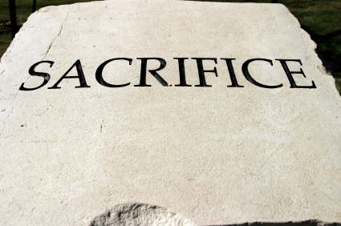
Identify two themes from the story & support with examples
Not giving up- Lenore really wanted to go to thunder bay to read her story and when her dad told her she couldn’t go she was sad but still kept trying until the night that she was going to read at parent and teacher night.
Sacrifice- her dad didn’t show up to the reading at parent teacher night when she asked him too and she really wanted him too and once it was her time to read and she saw he wasn’t there she ran off stage and said she was done, so she sacrificed her reading for her dad just because he didn’t show up.

Slide 3
Describe the elements of the story’s setting, time and place. Explain how the story would have changed if either time or place had been altered
The story takes place up north in this place called Spirt bay and is set in modern day.
If the time was changed in the story it would be different because if it was set back in time school didn’t matter as much as it does now. Not everyone went to university or something like it.

Slide 4
brief introduction to each character and their relationships
Lenore: is a girl in grade 10 with a amazing talent of writing, her dads opinion really matters to her and is the daughter of Pete and Connie and sister to Sadie.
Pete: a man that doesn’t know how to read and doesn’t like the idea of school and is the husband to connie and father od Lenore and Sadie.
Sadie: a girl who seems to try to help her sister when her sister can’t do it on her own and is a sister to elenore and daughter to Pete and Connie.
Connie: a wife to Pete and mother of Sadie and Lenore.

Slide 5
Retell the plot
The initial problem- the main problem in the story was Pete wouldn’t let Lenore go to thunder bay to read her story in a competition.
Rising action- Pete didn’t show up to parent teacher night when Lenore was reading her story and she lost some confidence in herself because after her dad didn’t show up to watch her wanted to quit.
The climax moment- the highest point in this story is when Lenore finally reads her story to her dad and he gets blown away.
Falling action- the falling action of when her dad finally tells her she’s allowed to go to thunder bay after he hears her read her story.
The resolution- when Lenore is done reading her story in thunder bay and everyone stands up and applauds her.

Slide 6
Evaluate the story with your personal response to it.
Connections I made: when her dad tells her she can’t go to thunder bay, I made a connection to that because lots of the time when I want to go somewhere really bad my parents say no sometimes too.
My thoughts/comments: I don’t understand why her dad didn’t want her to go to university at the beginning just because he doesn’t know how to read or know anything wouldn’t he want his daughter to know lots and not have to live the way he does, and want the best for his daughter? It seemed a little selfish to me.

Slide 7
what do you think was motivating each of the characters to act the way they were?
Between Pete and Lenore I think Pete was mad at first in the story because he couldn’t read which means he couldn’t read his daughters story and he was being selfish until the end then he got better.
How Lenore acted was because she was upset because Pete said she couldn’t go to thunder bay but she didn’t make a huge deal out of it, she only asked him about once or twice then her mom told her it’s better to not ask again and so she didn’t.

Slide 8
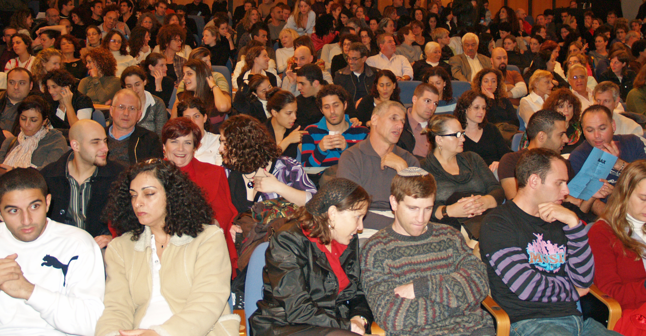
Can all audiences benefit from this, if they’re first nations or not?
I definitely think everyone can benefit from this because it sends a good message and lesson, and also kind of makes you think and someone who might not have it as good as you and put yourself in their shoes.

Slide 9
Was there internal or external conflict?
I think internal because she didn’t know if she should go and read without her dad then she didn’t and her dad ended up letting her go to thunder bay towards the end.

Slide 10
Between Lenore’s mom and teacher, how were their reactions to her fathers refusal different?
I think her mom kind of excepted it more because she knows Pete, and I don’t think her teacher excepted it because it was such a big opportunity for Lenore for him to give up like that and she was a little shocked too I think. I think her mom should’ve kind of stepped in a little and tried to help Lenore and let her go in the beginning.

Slide 11
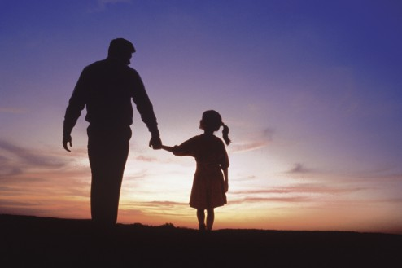
Lenore and Pete's relationship
At the start it wasn’t super strong it was a little weak but kind of normal, and towards the end it became really strong. I could tell it became stronger because he ended up letting Lenore go to thunder bay and he stood up and applauded Lenore and looked at her like he was really proud of her and that’s two ways I could tell it became stronger towards the end.

Slide 12
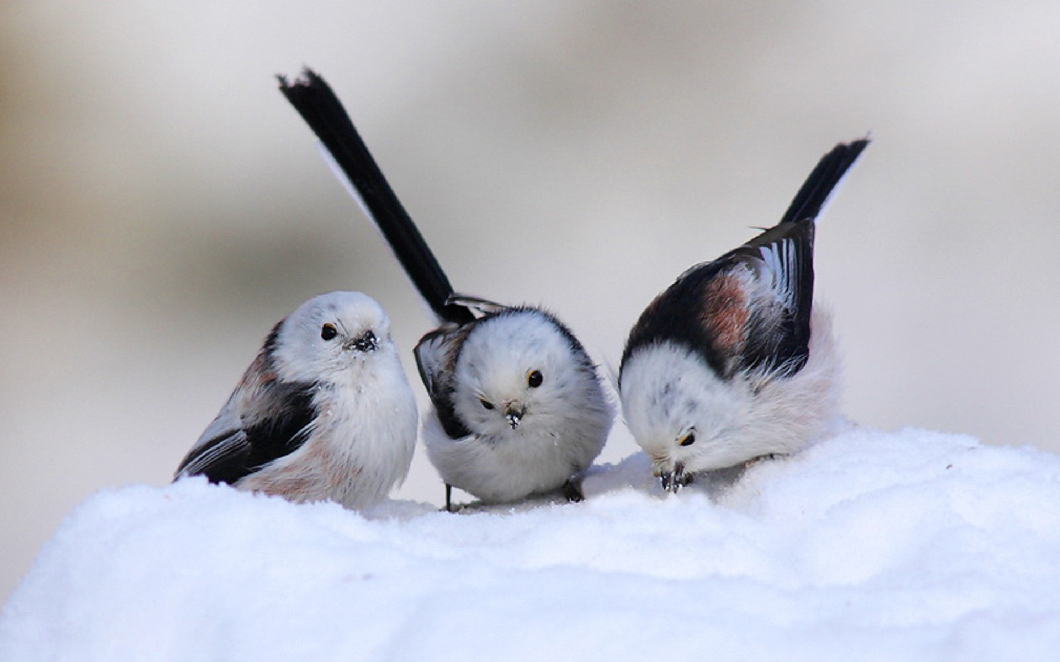
What do the birds symbolize?
I think the birds represent the first nations going into a white land and then coming back and bringing the knowledge of the white land.

Slide 13
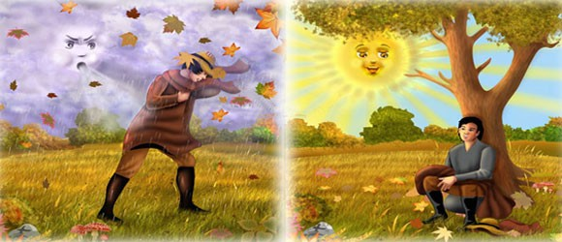
Retell the story on the sun and the wind.
There was a boy who was wearing a jacket and the wind wanted him to take his jacket off so the wind kept blowing and blowing and the boy got colder and held onto it tighter and tighter and then the sun came out and was nice and warm and kind and the boy took off the jacket.
This relates to Lenore because her mom told her if she keeps asking her dad Lenore would be like the wind and her dad wouldn’t say yes it would just make him want to say no more and her mom told her to be like r=the sun and so she didn’t keep asking and it worked and she was able to go to thunder bay in the end!

Slide 14
The end☺

